Slide 1

1.6.4 Geometric interpretation of complex numbers

Slide 2
Outline
In this topic, we will
  Review graphs of functions and the Cartesian plane
  Introduce the idea of the complex plane
  Describe the real and imaginary lines and the left- and right-hand planes

Slide 3
Geometric interpretations
You know how to represent:
  Integers
  Rational numbers
  Real numbers
½
π
–4
–3
–2
–1
0
1
2
3
4

Slide 4
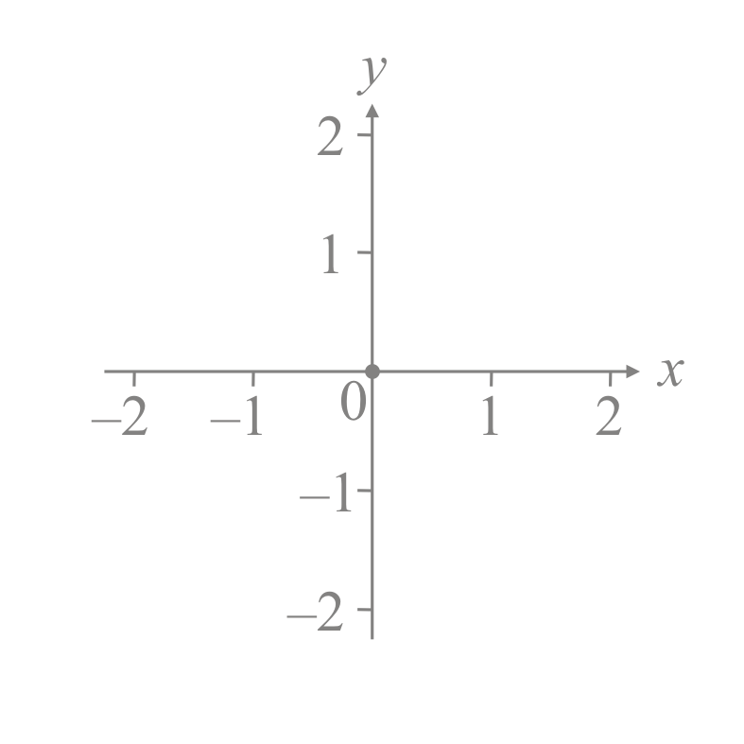
Geometric interpretations
Question: How do we interpret α + jβ ?
  Both α and β are real numbers…
Consider the representation of x and y when plotting functions
y = f( x )
  Any point where y = 0 is said to
  lie on the x-axis
  Any point where x = 0 is said to
  lie on the y-axis

Slide 5
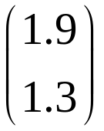
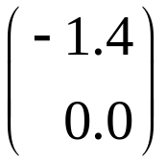
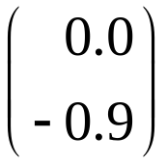
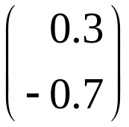
The Cartesian plane
Question: How do we interpret α + jβ ?
  Both α and β are real numbers…
Similarly, a 2-dimensional vector could be viewed on such axes
  Any 2d-vector where the second
  coordinate is zero is on the x-axis
  Any 2d-vector where the first
  coordinate is zero is on the y-axis
  This is called the Cartesian plane

Slide 6
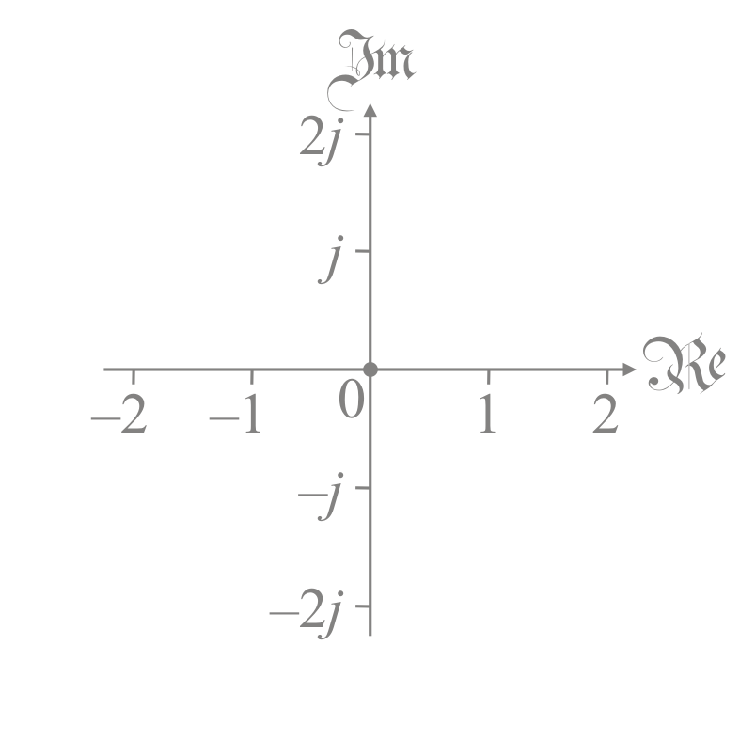
The complex plane
We will plot the complex number α + jβ in the same way as way we plot a two-dimensional vector
  Remember, a complex number
  is a single value
    Like a real number or an integer
  It is not a two-dimensional vector
This representation will be
called the complex plane

Slide 7


Real and imaginary axes
A complex number with zero imaginary part will be said to lie
on the real axis or the real line
  If z = 1.2 + j0, it is still a complex number, even though it is also real
  Just like ½ is still a real number, even though it is also a rational
A complex number with zero real
part will be said to lie on the
imaginary axis or line
  Such numbers are called
  imaginary

Slide 8



The complex plane
If α + jβ does not lie on either axis, we plot it so that
  The real component lines up on the real axis
  The imaginary component lines up on the imaginary axis

Slide 9

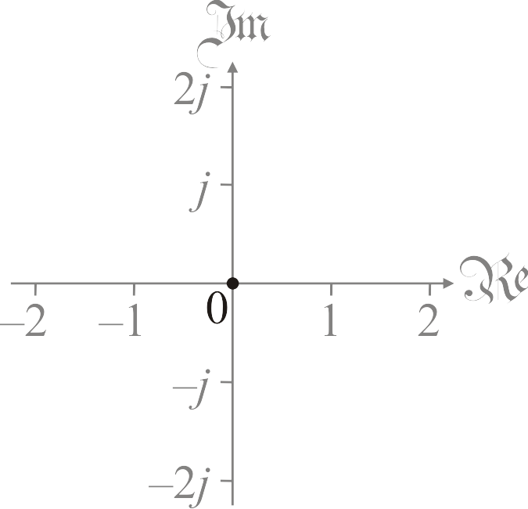
The complex plane
We will classify complex numbers based on the sign of the real parts, so given z = α + jβ
  If α > 0, we will say z lies in the open right-hand plane
  If α ≥ 0, we will say z lies in the closed right-hand plane
    The open right-hand plane
    and the imaginary axis
Recall the concept of an open
interval (0, 1)
  It does not contain the boundary
  points 0 or 1

Slide 10
The complex plane
Similarly, given z = α + jβ
  If α < 0, we will say z lies in the open left-hand plane
  If α ≤ 0, we will say z lies in the closed left-hand plane

Slide 11
Summary
In this topic, you now
  Understand the concept of the complex plane
  Can plot a point in that plane
  Know the terms real and imaginary axes
    Also called the real and imaginary lines
  Know the terms open and closed left- and right-hand planes

Slide 12
References
[1] https://en.wikipedia.org/wiki/Complex_plane

Slide 13
Acknowledgments
None so far.

Slide 14



Colophon
These slides were prepared using the Cambria typeface. Mathematical equations use Times New Roman, and source code is presented using Consolas. Mathematical equations are prepared in MathType by Design Science, Inc.
Examples may be formulated and checked using Maple by Maplesoft, Inc.
The photographs of flowers and a monarch butter appearing on the title slide and accenting the top of each other slide were taken at the Royal Botanical Gardens in October of 2017 by Douglas Wilhelm Harder. Please see
https://www.rbg.ca/
for more information.

Slide 15
Disclaimer
These slides are provided for the ne 11 Linear algebra for nanotechnology engineering course taught at the University of Waterloo. The material in it reflects the authors’ best judgment in light of the information available to them at the time of preparation. Any reliance on these course slides by any party for any other purpose are the responsibility of such parties. The authors accept no responsibility for damages, if any, suffered by any party as a result of decisions made or actions based on these course slides for any other purpose than that for which it was intended.

